Slide 1
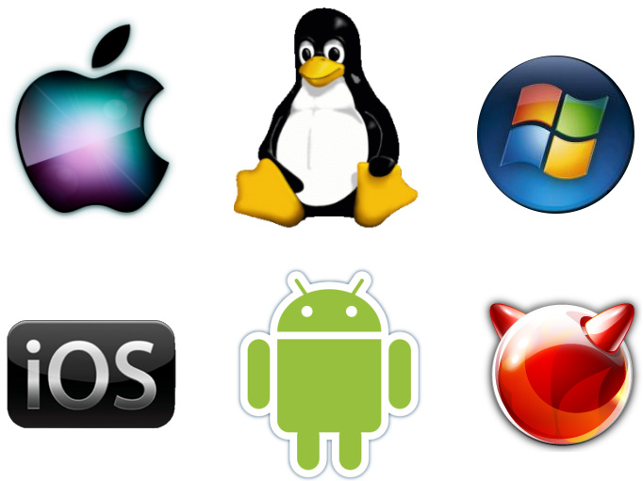
Operating System (O.S)
Lect-2

Slide 2
Types of O.S
Operating systems are there from the very first computer generation. Operating systems keep evolving over the period of time. Following are few of the important types of operating system which are most commonly used.
Types of O.S
Batch O.S
Distributed O.S
Time-Sharing O.S
Network O.S
Real-Time O.S

Slide 3
Batch operating system
The users of batch operating system do not interact with the computer directly.
Each user prepares his job on an off-line device like punch cards and submits it to the computer operator.
To speed up processing, jobs with similar needs are batched together and run as a group.
Thus, the programmers left their programs with the operator.
The operator then sorts programs into batches with similar requirements.
The problems with Batch Systems are following.
Lack of interaction between the user and job.
CPU is often idle, because the speeds of the mechanical I/O devices is slower than CPU.
Difficult to provide the desired priority.

Slide 4
Time-sharing operating systems
Time sharing is a technique which enables many people, located at various terminals, to use a particular computer system at the same time.
Time-sharing or multitasking is a logical extension of multiprogramming.
Processor's time which is shared among multiple users simultaneously is termed as time-sharing.
The main difference between Multiprogrammed Batch Systems and Time-Sharing Systems is that in case of Multiprogrammed batch systems, objective is to maximize processor use, whereas in Time-Sharing Systems objective is to minimize response time.
Multiple jobs are executed by the CPU by switching between them, but the switches occur so frequently.
Thus, the user can receives an immediate response.
For example,
in a transaction processing, processor execute each user program in a short burst or quantum of computation.
That is if n users are present, each user can get time quantum.
When the user submits the command, the response time is in few seconds at most.

Slide 5
Time Sharing (Multitasking )
Time sharing means many user can share the Computer simultaneously
Time sharing is like a multiprogramming but interactive(provide direct communication between user and system , where user expect immediate result) instead of batch
Time sharing is a technique of scheduling the C.P.U time so that they can share multiple task and user.
Time sharing is a sharing of resources among many users by means of multiprogramming and multitasking
No. of user at different terminals use the single computer at a time for different purpose. Hence more than one job process simultaneously

Slide 6
Time Sharing(Multitasking)
In Time sharing the C.P.U time is divided among all user and give fix time to each other
In Time sharing O.S share time between task
For Example:
Job A take 6 min to complete but pre define time from the O.S system is 2 min, first O.S take job A and process it for 2 min after that O.S take Job B to process, when C.P.U is free O.S take job A and complete their remaining process in this C.P.U shared time among various job
In this Time sharing all program falls on following stages
Active
Time Allocation
I/O operator
costing
Ready
I/O complete
Waite

Slide 7
Cont…
Operating system uses CPU scheduling and multiprogramming to provide each user with a small portion of a time. Computer systems that were designed primarily as batch systems have been modified to time-sharing systems.
Advantages of Timesharing operating systems are following
Provide advantage of quick response.
Avoids duplication of software.
Reduces CPU idle time.
Disadvantages of Timesharing operating systems are following.
Problem of reliability.
Question of security and integrity of user programs and data.
Problem of data communication.

Slide 8
Distributed operating System
Distributed systems use multiple central processors to serve multiple real time application and multiple users.
Data processing jobs are distributed among the processors accordingly to which one can perform each job most efficiently.
The processors communicate with one another through various communication lines (such as high-speed buses or telephone lines).
These are referred as loosely coupled systems or distributed systems.
Processors in a distributed system may vary in size and function.
These processors are referred as sites, nodes, computers and so on.

Slide 9
The advantages of distributed systems are following.
With resource sharing facility user at one site may be able to use the resources available at another.
Speedup the exchange of data with one another via electronic mail.
If one site fails in a distributed system, the remaining sites can potentially continue operating.
Better service to the customers.
Reduction of the load on the host computer.
Reduction of delays in data processing.

Slide 10
Network operating System
Network Operating System runs on a server and provides server the capability to manage data, users, groups, security, applications, and other networking functions.
The primary purpose of the network operating system is to allow shared file and printer access among multiple computers in a network, typically a local area network (LAN), a private network or to other networks.
Examples of network operating systems are Microsoft Windows Server 2003, Microsoft Windows Server 2008, UNIX, Linux, Mac OS X, Novell NetWare, and BSD.

Slide 11
Cont…
The advantages of network operating systems are following.
Centralized servers are highly stable.
Security is server managed.
Upgrades to new technologies and hardwares can be easily integrated into the system.
Remote access to servers is possible from different locations and types of systems.
The disadvantages of network operating systems are following.
High cost of buying and running a server.
Dependency on a central location for most operations.
Regular maintenance and updates are required.

Slide 12
Real Time operating System
Real time system is defines as a data processing system in which the time interval required to process and respond to inputs is so small that it controls the environment.
Real time processing is always on line whereas on line system need not be real time.
The time taken by the system to respond to an input and display of required updated information is termed as response time.
So in this method response time is very less as compared to the online processing.
Real-time systems are used when there are rigid time requirements on the operation of a processor or the flow of data and real-time systems can be used as a control device in a dedicated application.
Real-time operating system has well-defined, fixed time constraints otherwise system will fail.
For example Scientific experiments, medical imaging systems, industrial control systems, weapon systems, robots, and home-applicance controllers, Air traffic control system etc.

Slide 13
Types of real-time operating systems
There are two types of real-time operating systems.
Types of Real-Time O.S
Hard Real-Time System
Soft Real-Time System

Slide 14
Types of real-time operating systems
Hard real-time systems
Hard real-time systems guarantee that critical tasks complete on time.
In hard real-time systems secondary storage is limited or missing with data stored in ROM.
In these systems virtual memory is almost never found.
Soft real-time systems
Soft real time systems are less restrictive.
Critical real-time task gets priority over other tasks and retains the priority until it completes.
Soft real-time systems have limited utility than hard real-time systems.
For example, Multimedia, virtual reality, Advanced Scientific Projects like undersea exploration and planetary rovers etc.

